Slide 1
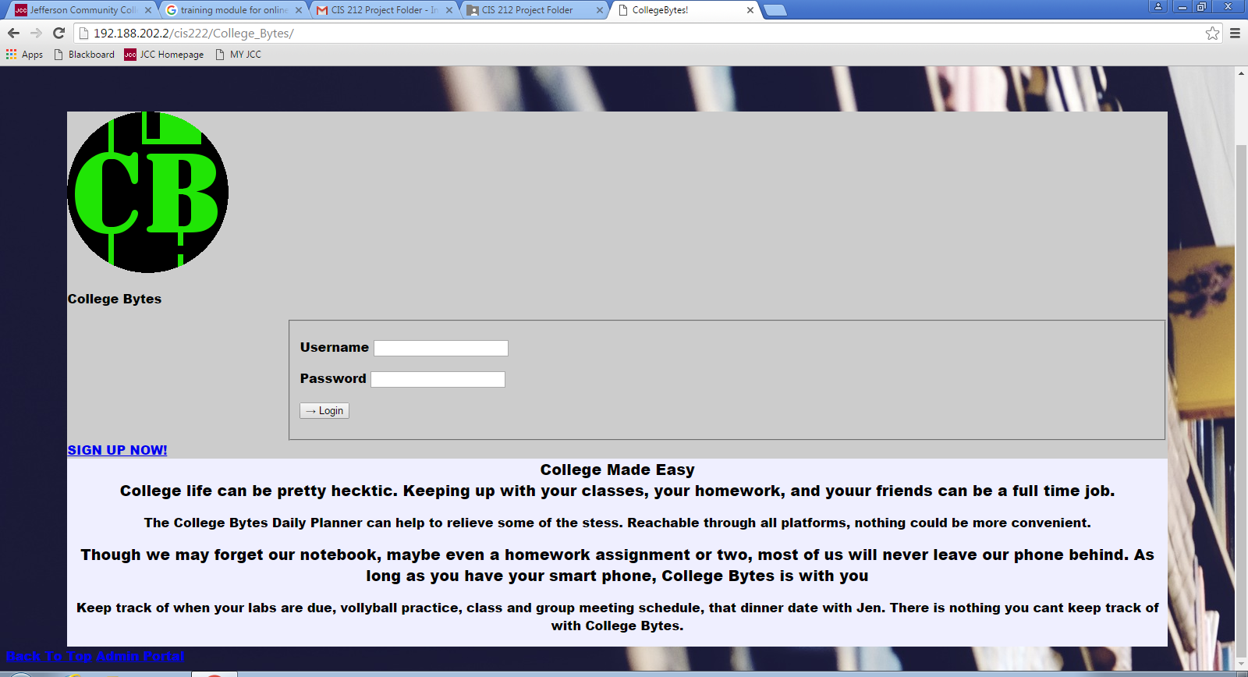
Create new user
Click on SIGN UP NOW
Click on SIGN UP NOW!

Slide 2
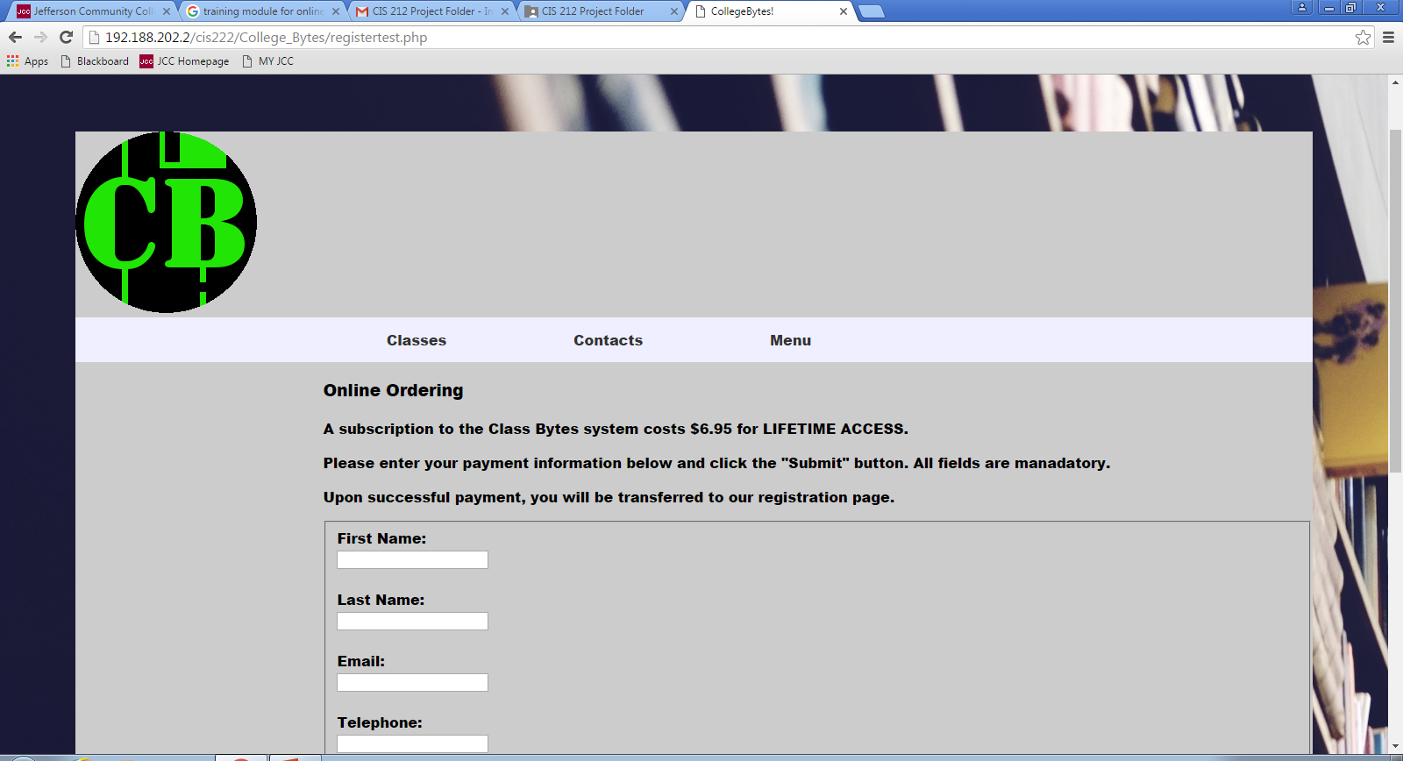
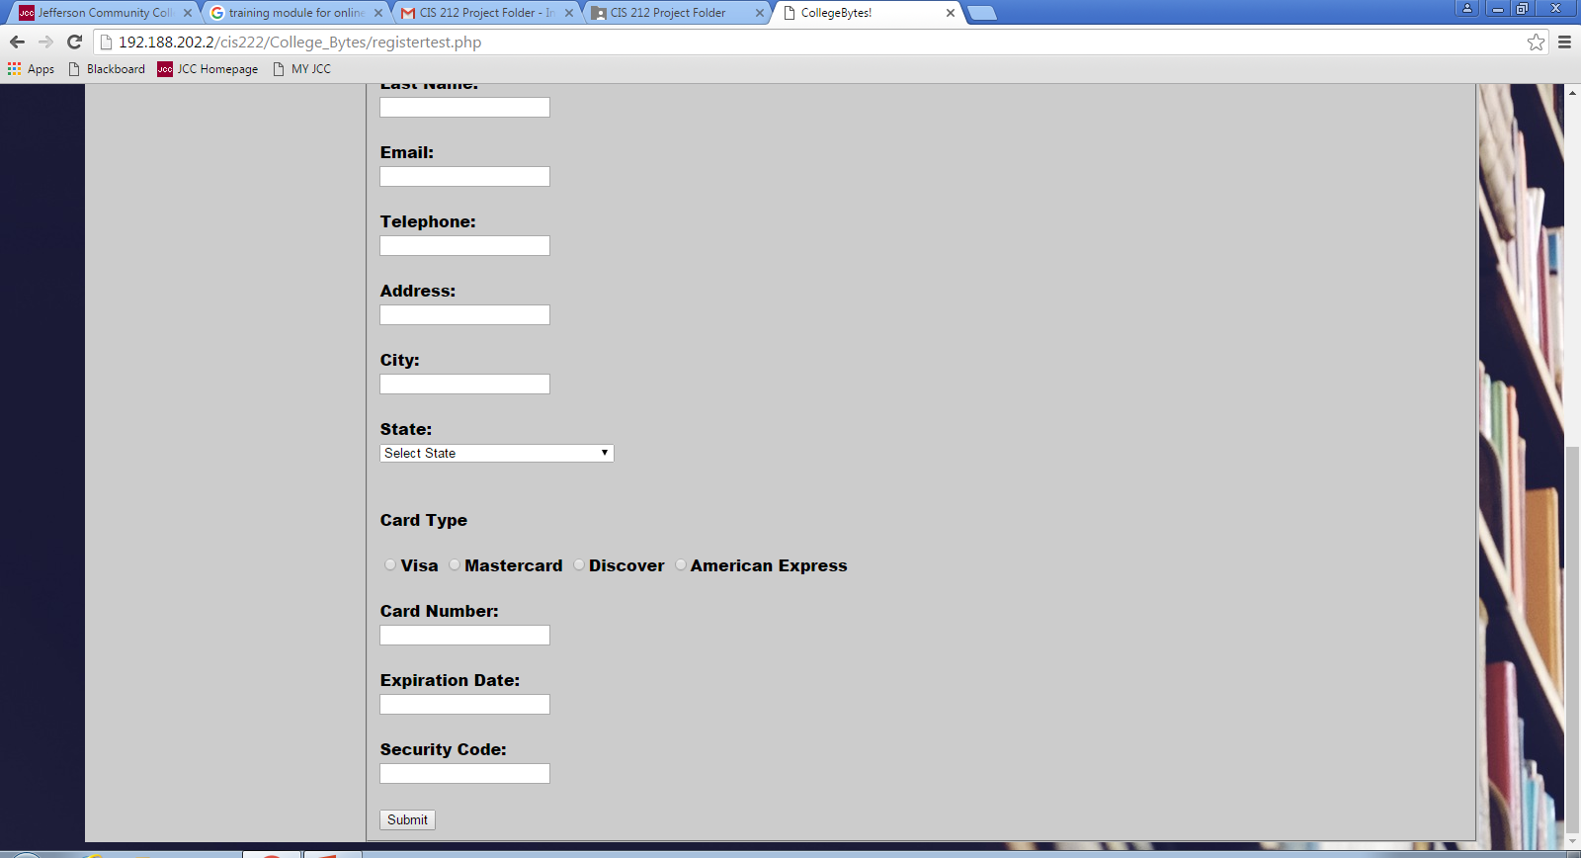
Fill in the necessary information
Fill in the necessary information
All fields should be filled out prior to submission

Slide 3
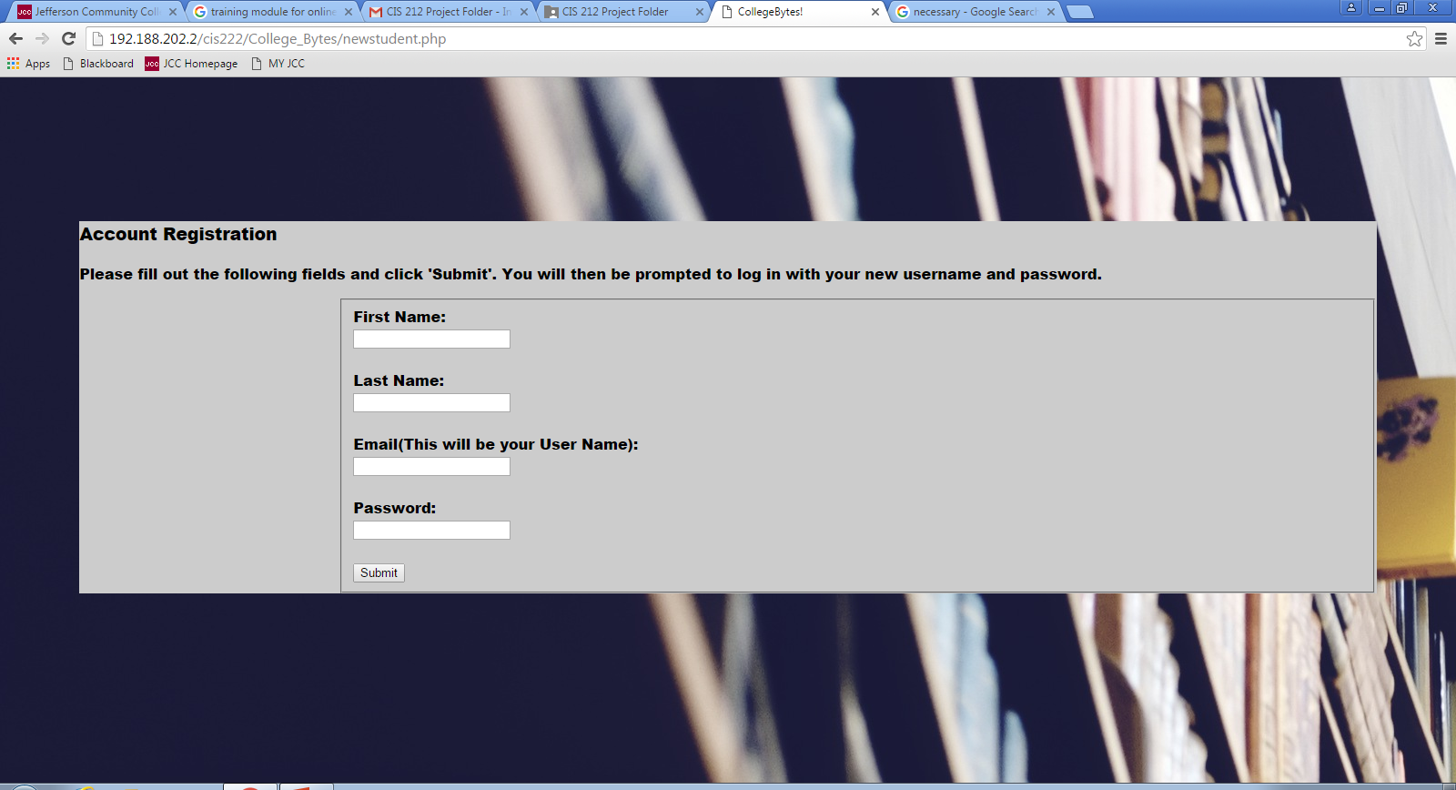
Fill in the all the fields and create a password

Slide 4

Enter the Email and Password you created on the previous screen

Slide 5
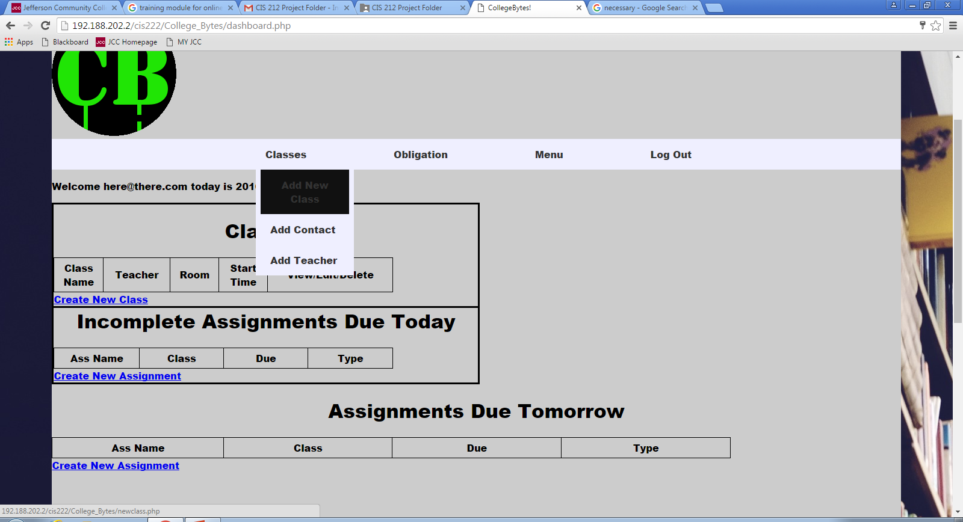
Create a New Class by selecting one of these links

Slide 6
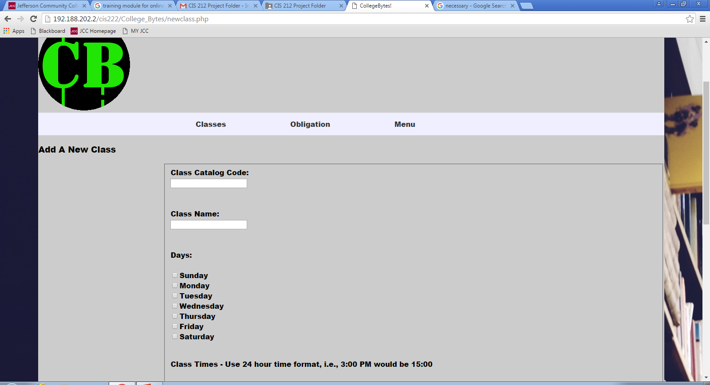
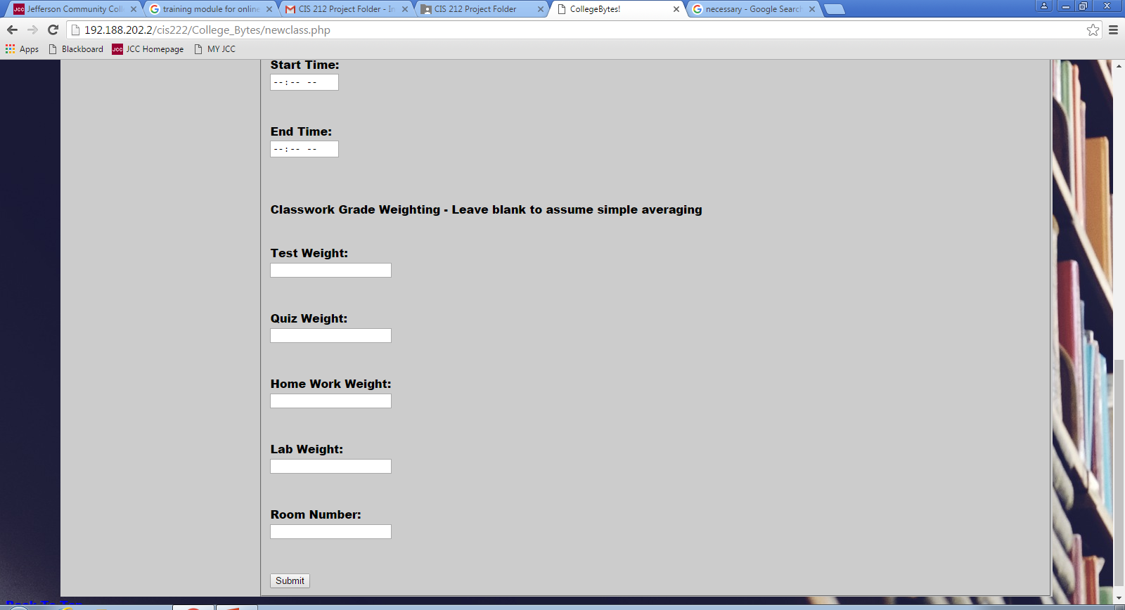
Enter all information regarding a single class
Select the days you must attend class
Select the times you must attend the class
Enter grading criteria regarding a single class

Slide 7
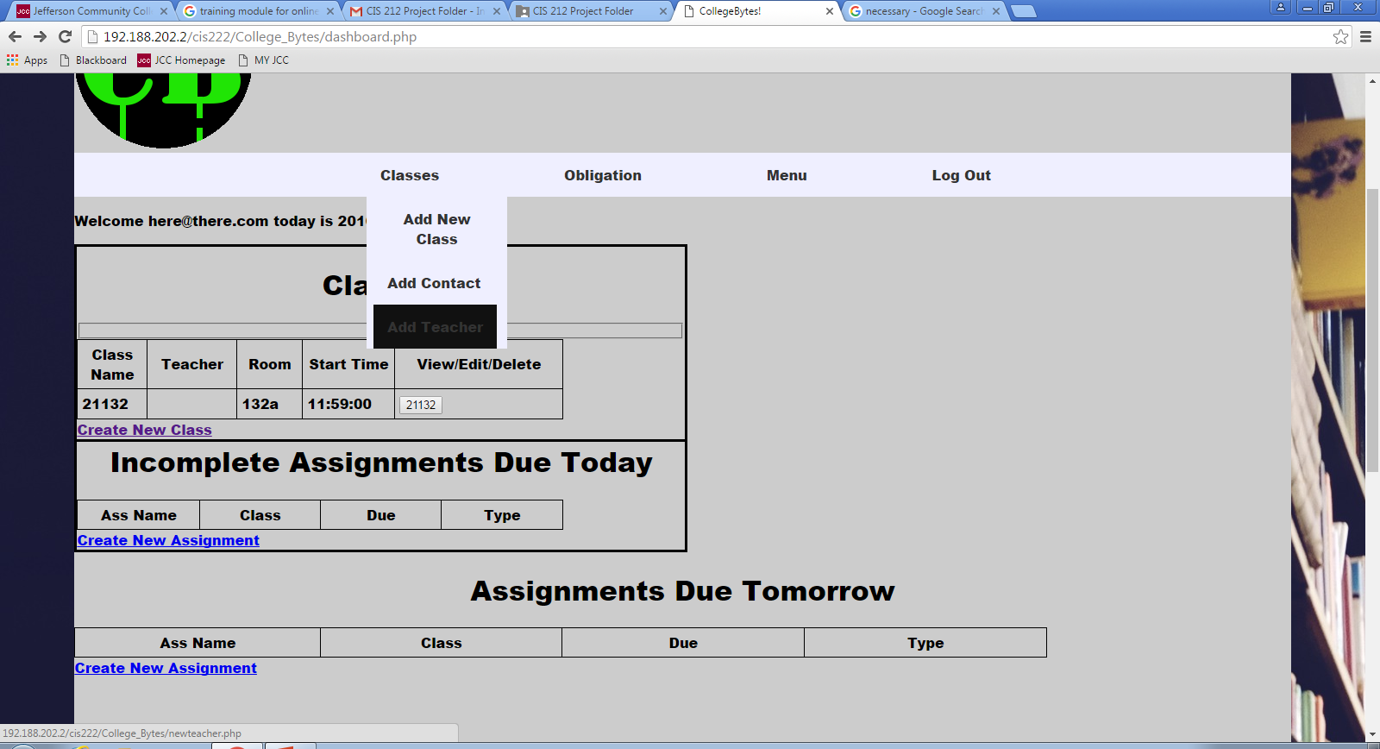
Add a teacher to previously added class
Notice the empty space for teacher

Slide 8
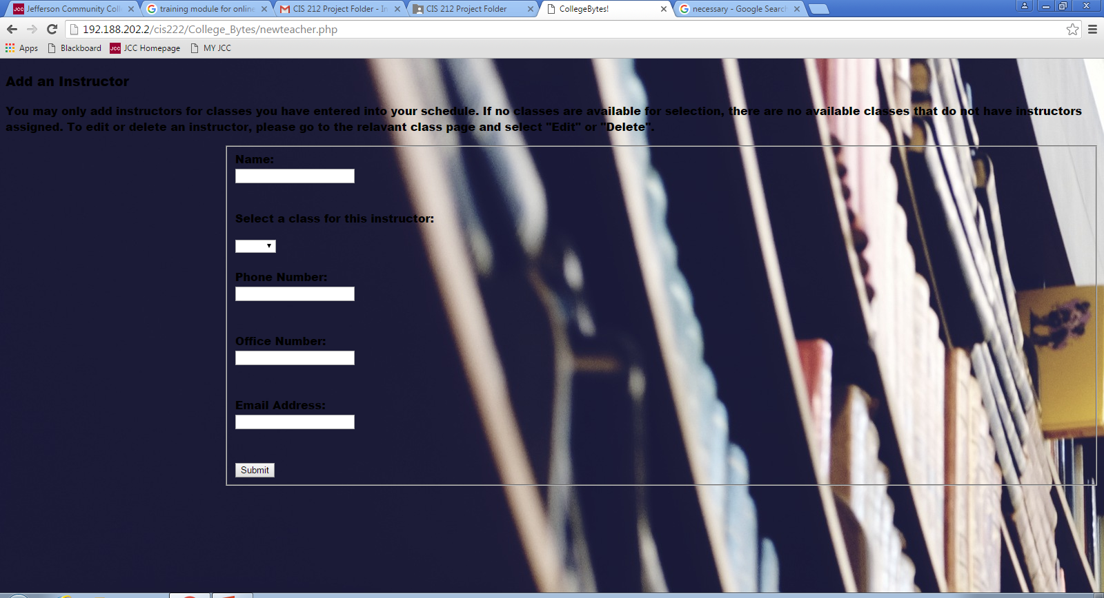
Enter teacher contact information. You will only be able to create a teacher for classes you have already created
Use the “Select a class for this instructor” to select which class to assign your teacher

Slide 9
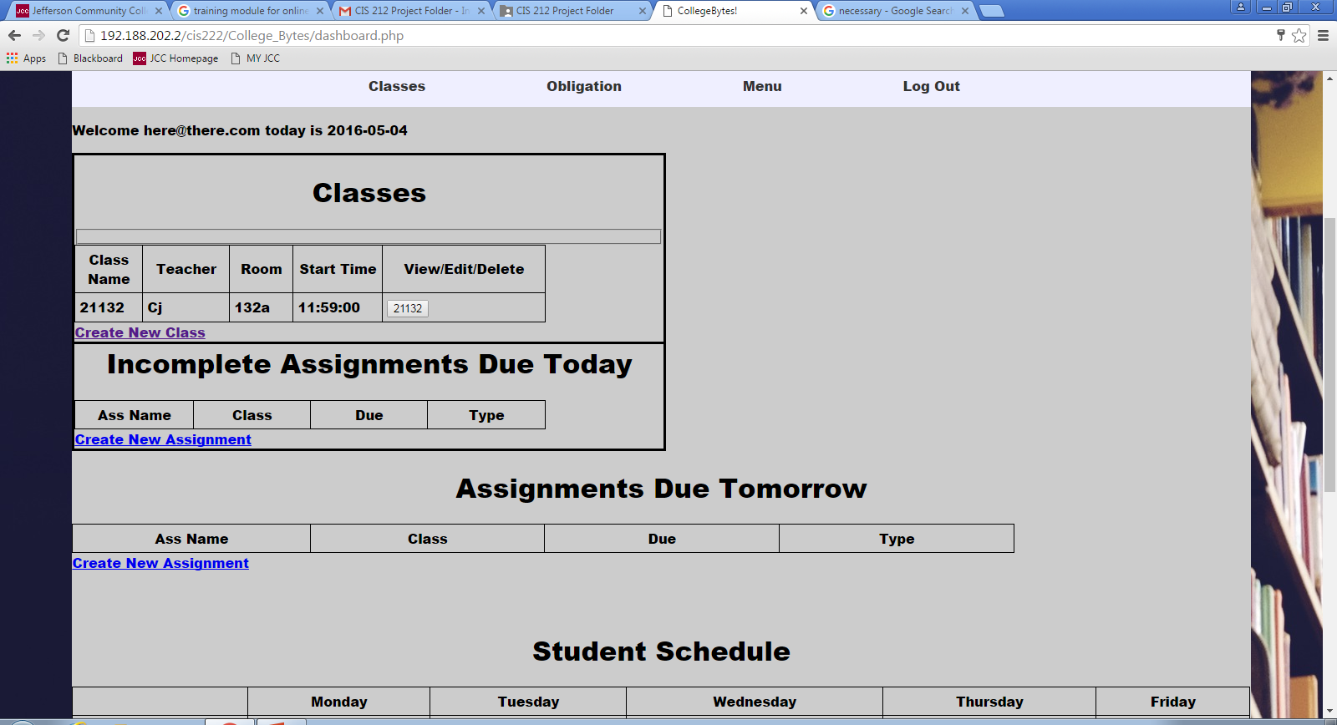
Create a new assignment.
Click on the Create New Assignment

Slide 10
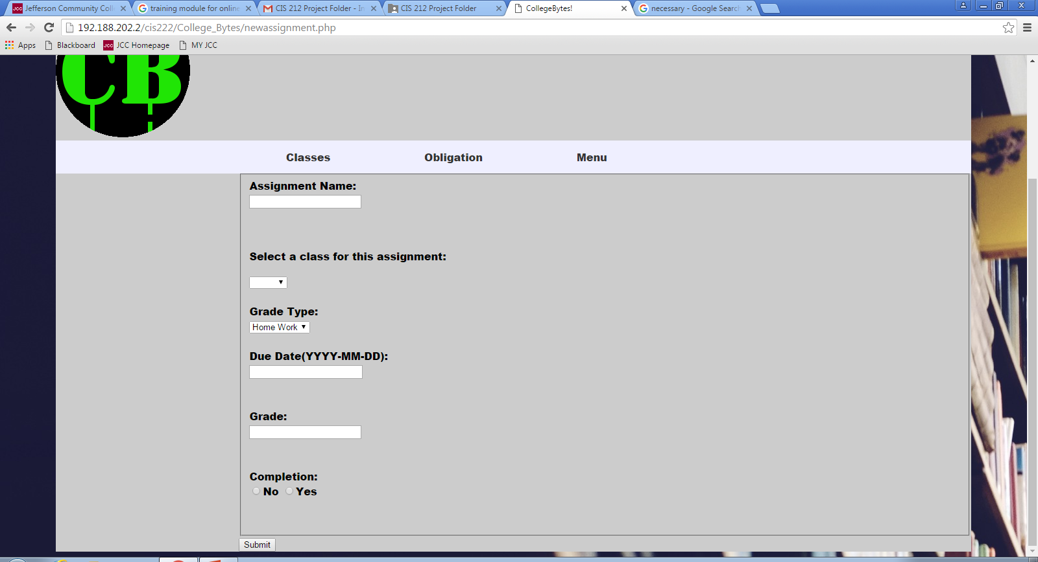
Fill in the appropriate fields for each assignment.

